Slide 1
Welcome to 3rd Grade!
Miss Bohn
Mrs. Shao
Tarwater Elementary School

Slide 2
Message from Our Principal
https://www.cusd80.com/Page/97369

Slide 3
Goals
Our goals as your student’s teachers are to…
Provide them with a safe and secure learning environment.
Provide a strong instructional foundation.
Encourage them to always do their best.

Slide 4
English Language Arts
This year in ELA, students will work on reading and social studies skills.
Reading/Language –comprehension, phonics, grammar, spelling, vocabulary all done through novel studies
Social Studies – Arizona Studies – civics, economics, geography

Slide 5
Mandarin Language Arts
This year in Mandarin, students will focus on language skills and science.
Mandarin - language skills in reading, writing, listening and speaking
Better Immersion and Mandarin Matrix
Science – living things, food chains, Earth’s major systems, water cycle, ecosystems, plant/animal structure and light/sound energy

Slide 6
Math
We will continue using Engage New York.
Students will have the opportunity based on placement test to be in the accelerated class (4th grade math).

Slide 7
Independent Reading & Math facts
Math Fact Fluency will be completed daily in your child’s homeroom.
Math facts will return home to practice and reinforce skills
AR is NOT a requirement this year. Students are welcome to take AR tests if they’d like. During class time we will have independent reading time as well as nightly reading homework.

Slide 8
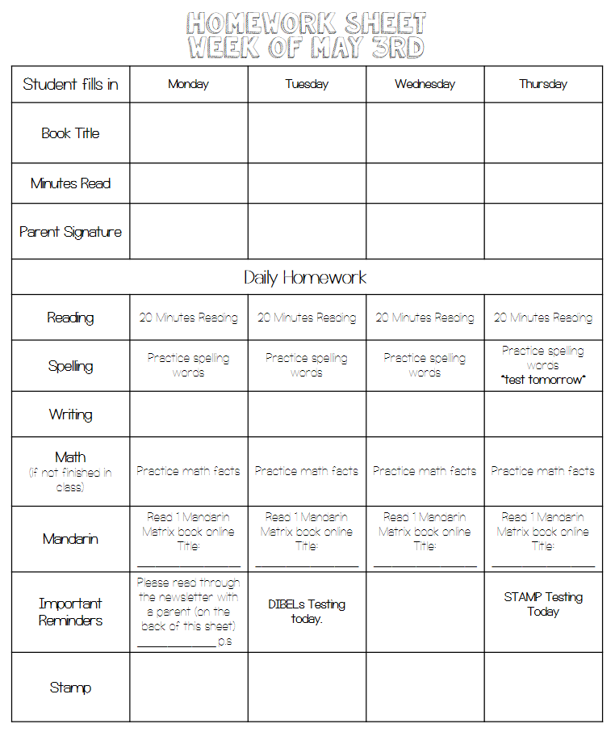
Newsletter and Homework
Newsletters are sent home on Fridays
On the back is the homework sheet. Students are required to read nightly and have it signed by parents.

Slide 9
Communication
Email is the best way to communicate with both Miss Bohn and Mrs. Shao.
Weekly emails will be sent on Fridays with:
Following week’s newsletter
Important events/dates coming up
Other information

Slide 10
Grades
Grades are based off classwork and tests…
100%-90% = A
89%-80% = B
79%-70% = C
69%-60% = D
59%-lower = F
We do not grade homework
Chances to redo work are available when students score below a 70%. Grades will be averaged for new score.

Slide 11
Absences
If you know your child will be out – please contact the attendance line.
(480) 883-4303
If your child will be out multiple days, we will collect work for their return.
If you would like it while your child is out, please contact both teachers. We’ll gather work to do at home.

Slide 12
Volunteers
If you haven’t already gotten in contact with us about volunteering, please send an email.
Volunteers are great for:
Copying
Small Groups (all subjects, even Mandarin if possible)
Math Facts
Field trips (more information to come)
Art Masterpiece
Home projects
End of the year video
Scholastic

Slide 13
Tax Credit
No more activity fees. Everything is based solely on tax credit donations.
Field Trips
Third grade performance (?)
Donations are all tax credit eligible meaning you will receive all of it back at tax time!
$200 for single return
$400 for joint return

Slide 14
Infinite Campus Portal
Report Cards and Progress Reports are ALL ONLINE!
Tax Credit, activity fees, and club fees are all paid through infinite campus.
Recommended to pay everything at once to avoid multiple fees
Need help?
Laurie Jones for fee questions and concerns
(480) 883-4307
Deb Ellis for login concerns and parent portal
(480) 883-4303

